Slide 1
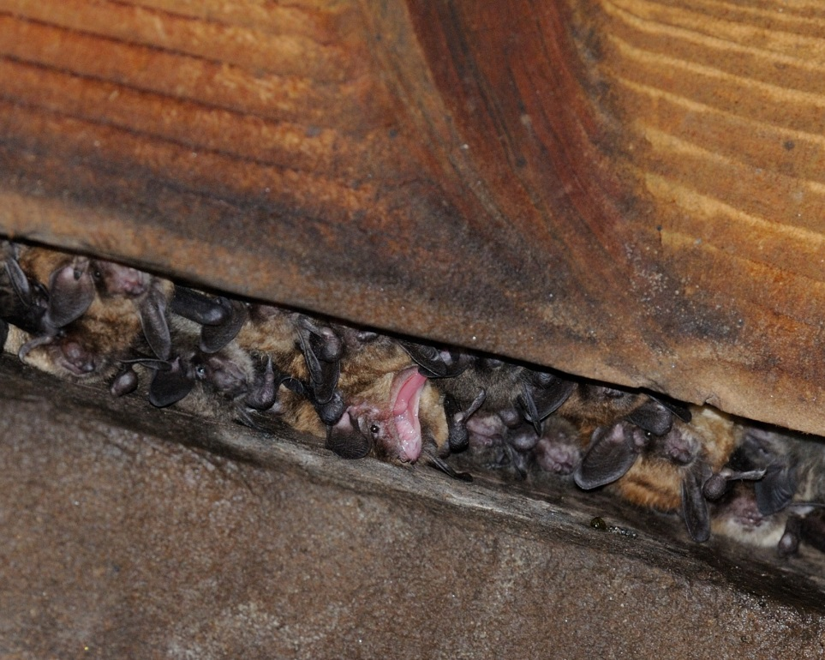
Status and Update on the Upper Delaware Bat Community
Jessica Newbern
Biologist
National Park Service
Upper Delaware Scenic and Recreational River

Slide 2
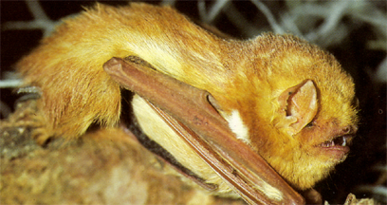
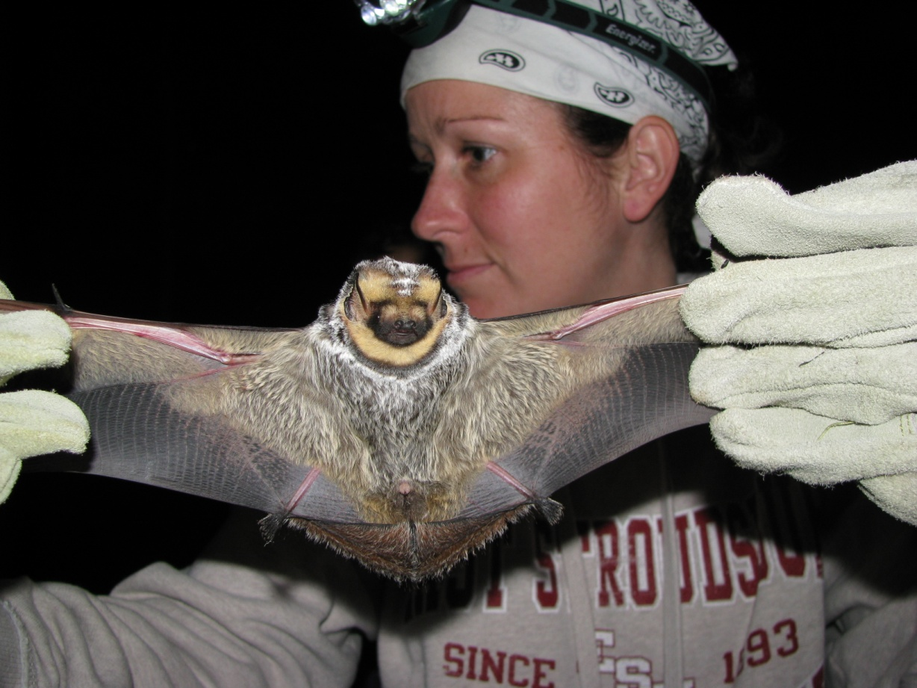
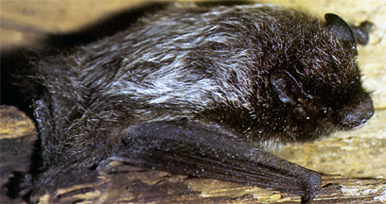
Tree bat species
Eastern red bat
Silver-haired bat
Hoary bat

Slide 3
Roosting bat species
Tri-color bat
Small-footed bat
Northern long-eared bat
Little brown bat
Big brown bat
Indiana bat
Photos taken from batmanagement.com

Slide 4
Why are Bats Important?
Pest Management
Forest pests
Agriculture pests
Biting insects
Pollinators and Fertilizers
Seed dispersal
Nectar feeding
Bat guano has many purposes
Fascinating mammals
Long-lived relative to their size
Reproduce once a year
Use echolocation for communication, foraging, and identify their surroundings
They can FLY!

Slide 5
Threats to bats
White Nose Syndrome (estimated loss >6 million bats in Northeast and Canada)
Wind energy (estimated loss 600,000/year)
Habitat Loss
Chiroptophobia (fear of bats)

Slide 6
Map of WNS Affected Areas

Slide 7
Bat Monitoring in UPDE
2008-2009 Small mammal inventory
Triple high and single high mist netting
Acoustic monitoring
Emergence counts
Captured 6 of the 9 species
Recorded 8 of the 9 species
2010 and 2012 Acoustic monitoring and emergence counts
2013 Acoustic monitoring, emergence counts, UPDE BioBlitz in Starlight, PA
2014 Acoustic monitoring, emergence counts, UPDE BioBlitz in Tusten, NY
2015 Mobile acoustic monitoring, emergence counts, a 3rd little brown bat colony identified in Tusten, NY
2016 - 2018 Mobile acoustic monitoring, stationary monitoring in NY, emergence counts at known roosts, UPDE BioBlitz in Starlight, PA

Slide 8
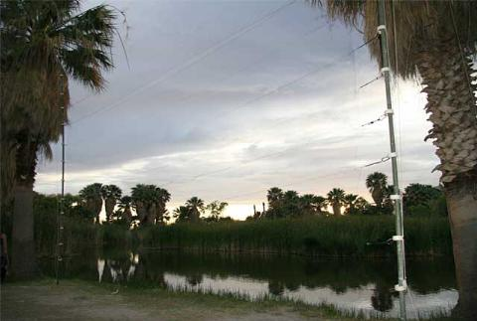
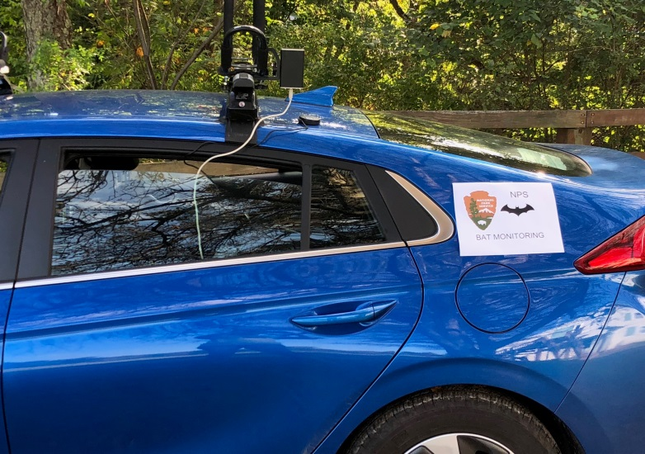
Mist Netting & Acoustic Monitoring

Slide 9
Mobile Acoustic Transects
Species | 2014 (n=10) | 2015 (n=12) | *2016 (n=10) | *2017 (n=12)
Big Brown | 65.56% | 65.42% | 62.00% | 53.94%
Eastern Red | 12.03% | 16.43% | 10.69% | 31.71%
Hoary | 2.11% | 3.17% | 7.38% | 7.64%
Myotis Sp. | 10.68% | 6.77% | 8.58% | 3.47%
Little Brown | 6.47% | 6.05% | 6.47% | 3.24%
Silver-haired | 1.05% | 1.01% | 3.60% | 4.17%
Tri-Colored | 1.05% | 0.43% | 0.50% | 0.69%
Indiana | 1.05% | 0.72% | nd | 0.23%
Norhtern long-earred | nd | nd | 0.30% | nd
Eastern small-footed | nd | nd | 0.30% | nd

Slide 10
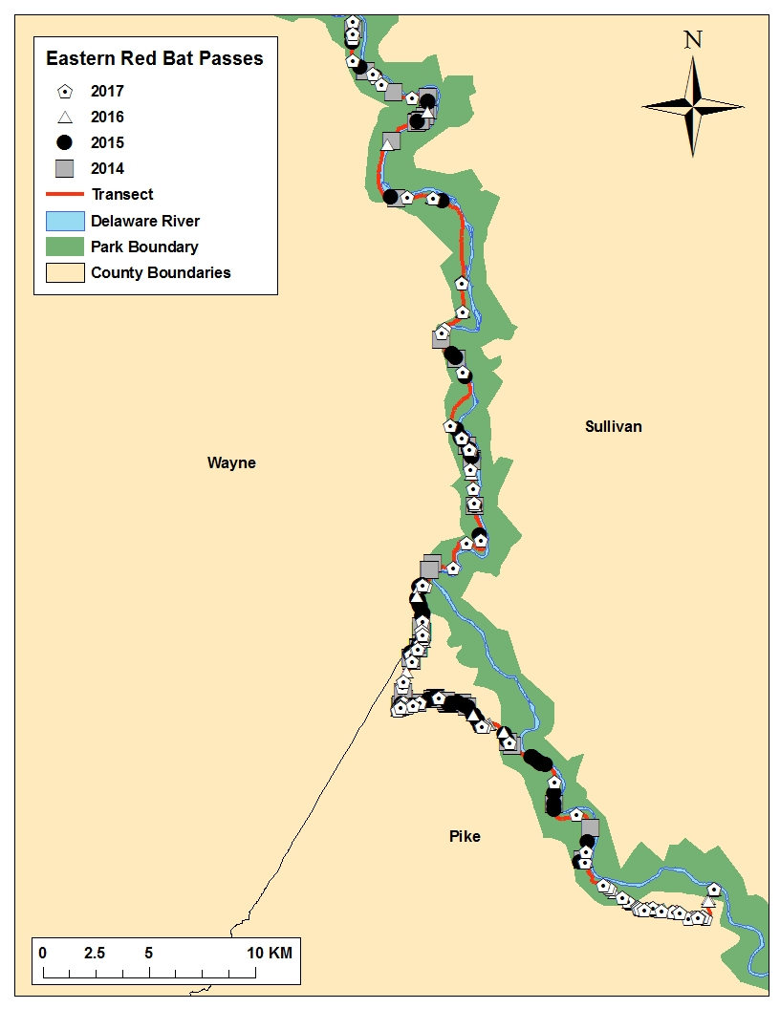
Mobile Acoustic Transects

Slide 11
Mobile Acoustic Transects

Slide 12
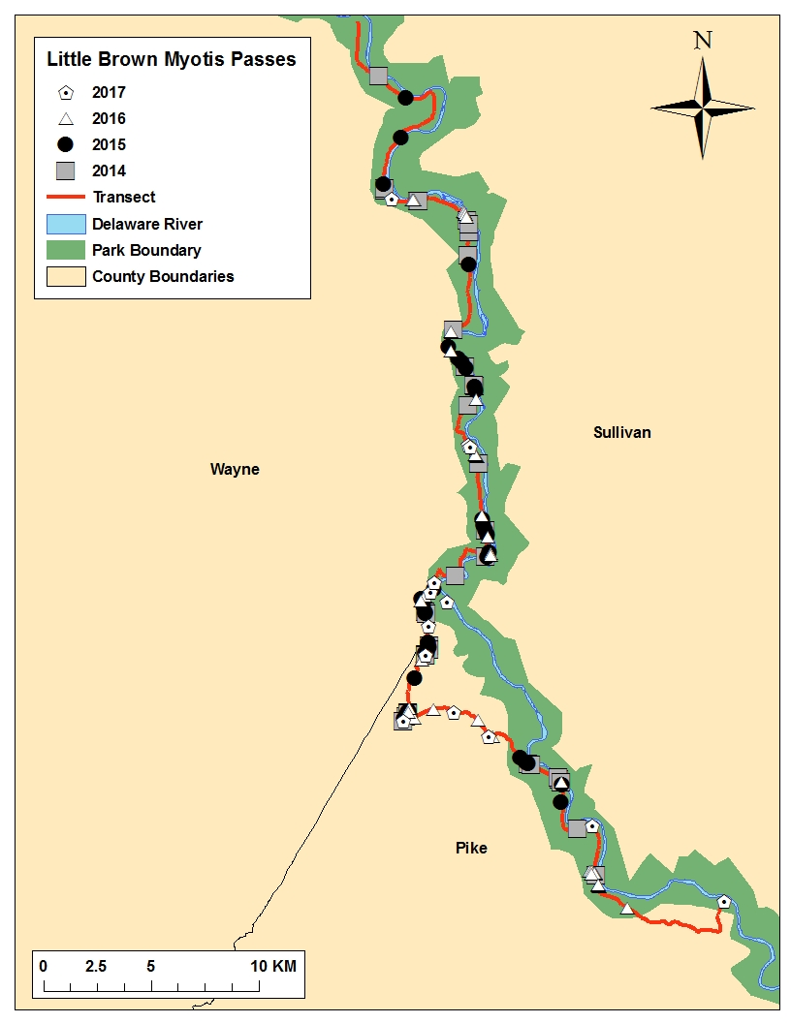
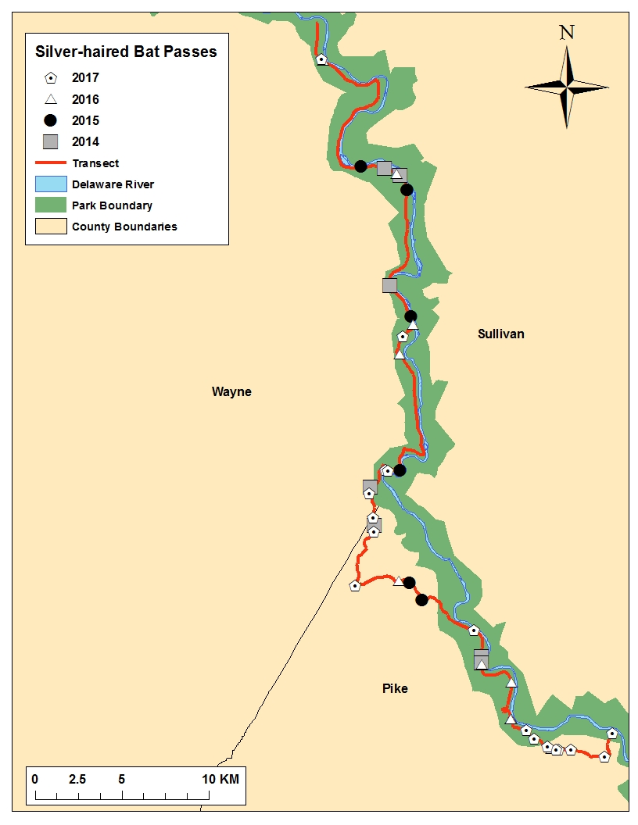
Mobile Acoustic Transects

Slide 13
Mobile Acoustic Transects

Slide 14
Maternity Roost Emergence Counts
Lackawaxen Post Office
Date | 30-May- 2014 | 7-Jun-2014 | 14-un-2014 | 25-Jul-2014 | 7-Jun-2015 | 11-Jul-2015 | 16- Jul-2015 | 26-May-2016 | 30- Jun-2016 | 21-Jul-2016 | 18-May-2017 | 19-Jul-2017
Number of Bats | 295 | 422 | 487 | 503 | 362 | 592 | 632 | 361 | 497 | 612 | 351 | 501
Cochecton Train Station
Date | 16-Jul-2014 | 22-Jul-2014 | 30-Jul-2014 | 24-Jun-2015 | 28-Jul-2015 | 11-May-2016 | 31-May-2016 | 2- Aug- 2016 | 21-Jun- 2017
Number of Bats | 145 | 118 | 101 | 60 | 78 | 64 | 63 | 71 | 64

Slide 15
2019-2021 WNS Funding
NPS Biological Resources Division WNS funding - UPDE awarded $114,000
Partnering with East Stroudsburg University, Dr. Whidden
Repeat mist netting surveys to include NY
Pilot citizen science project
Attempt to find more little brown bat maternity colonies
Testing bats for exposure to fungus causes WNS
Continue mobile acoustic transects incorporating shorter ones
Banding or radiotelemetry to find hibernacula

Slide 16
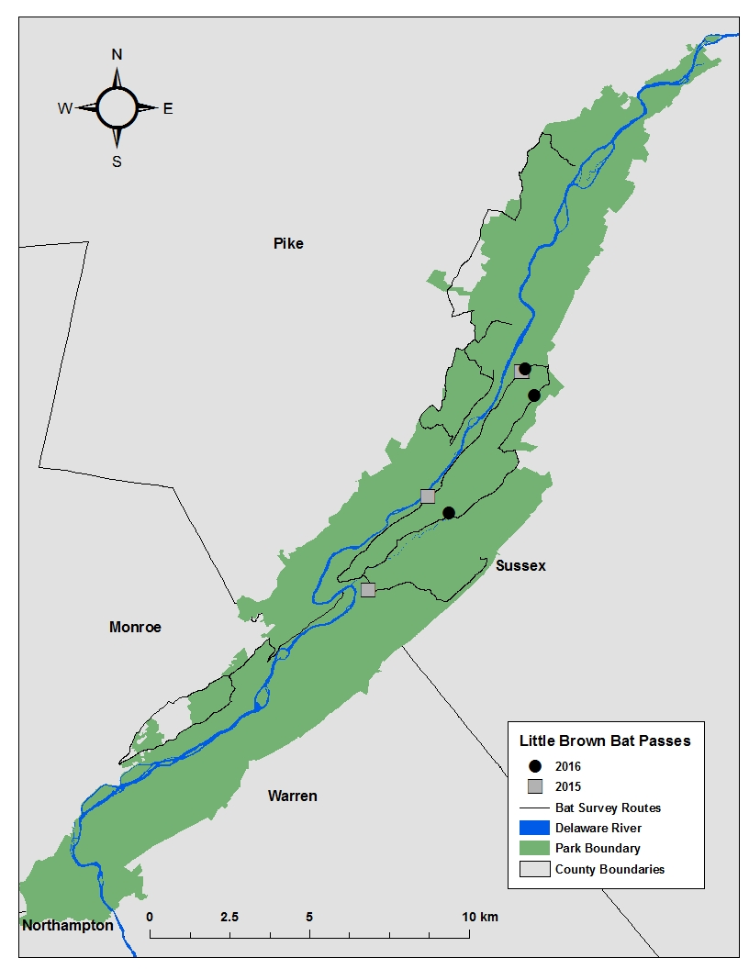
Mobile Acoustic Transects

Slide 17
How Can We Help Bats?
Education
Public involvement with bat monitoring and bat activities (national bat day, bat week)
Choose alternatives
Continue to monitor bats in the park for changes in species composition or WNS affects

Slide 18
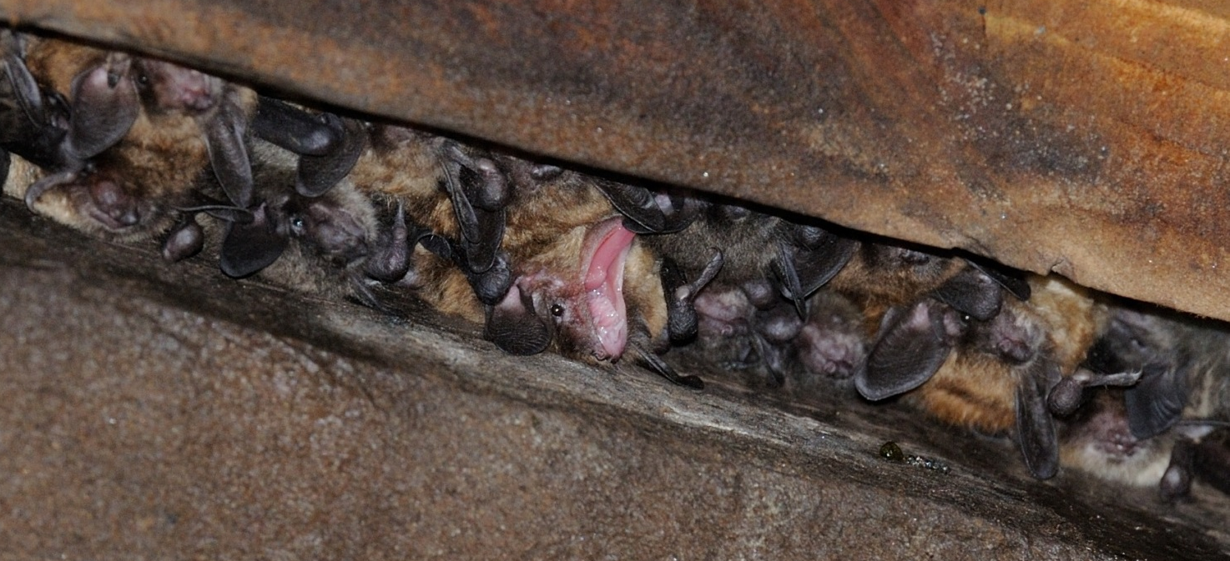
Questions
Jessica Newbern
Biologist
National Park Service
Upper Delaware Scenic and Recreational River
570-729-7842 x3301
JNewbern@nps.gov

